Slide 1



Quantum Teleportation Simulation
Aiden Rader • Daniel Geise • Rafael Sanches Gambim
Notes:
“Today we’re presenting our implementation of the quantum teleportation protocol using Qiskit. We simulated teleporting four different qubit states and compared ideal simulation results with real IBM quantum hardware. Our team is Aiden, Daniel, and Rafael.”

Slide 2
Project Overview
Implemented standard quantum teleportation protocol
Tested four representative qubit states (|0>, |1>, |+>, |−>)
Compared ideal simulation vs real IBM hardware
Notes:
“Quantum teleportation moves information, not matter. Alice has an unknown qubit, and she shares an entangled pair with Bob. After measuring her qubits, she sends two classical bits to Bob. With those, Bob applies the correct operations and ends up with the original state. Alice’s qubit is destroyed in the process, so the no-cloning theorem isn’t violated.”

Slide 3
Research Questions
How does fidelity vary across different input states?
How does hardware noise impact teleportation performance?
Notes:
“We focused on fidelity — how close the teleported qubit is to the original. We tested four standard states. We also wanted to see how big the gap is between perfect simulated teleportation and running the same circuit on an actual IBM quantum processor.”

Slide 4
Methodology
Qiskit-based modular teleportation module
State preparation functions for |0>, |1>, |+>, |−>
Unitary-based correction instead of classical control
Fidelity via partial trace + state_fidelity
Notes:
“We built a modular Python implementation in Qiskit. Each input state had its own prep function. The teleportation protocol used three qubits: the input, plus a Bell pair. After running the circuit, we extracted Bob’s final qubit using a partial trace and compared it to the ideal version of the same state using Qiskit’s fidelity function.”

Slide 5
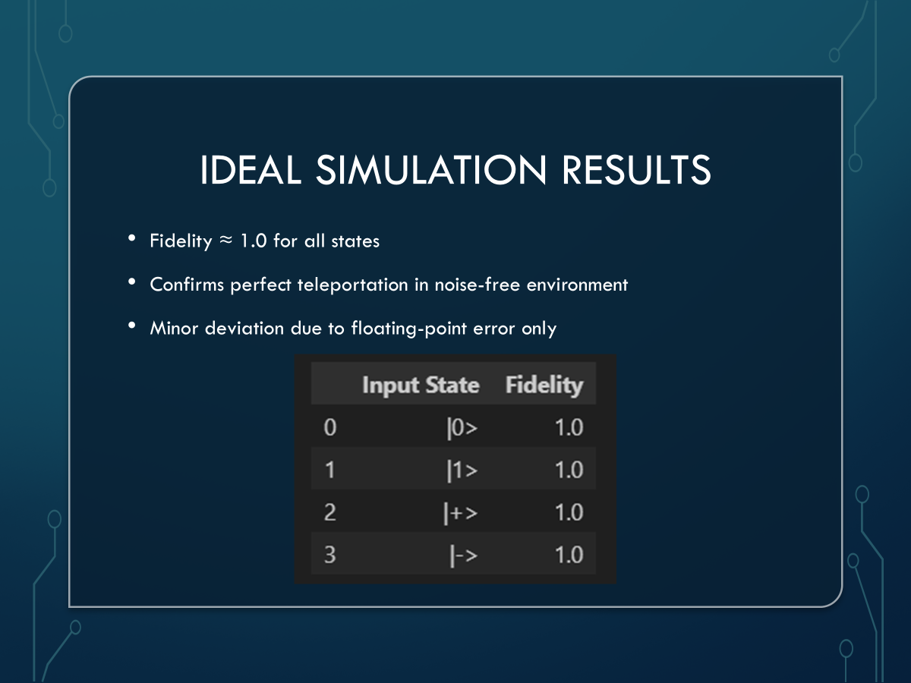
Teleportation Protocol
Prepare unknown input state on q0
Create Bell pair between q1 and q2
Alice performs CNOT + Hadamard (Bell basis)
Bob applies correction operations
Notes:
“The input state goes on q0. To create the shared resource, we put q1 into superposition and entangle it with q2. Alice then entangles q0 with q1 using CNOT and Hadamard — that’s the Bell measurement stage. Instead of literal classical measurement, we used equivalent unitary gates to create the corrected state coherently. In an ideal environment, this is mathematically identical.”

Slide 6
Hardware Results
Fidelity dropped to ~0.50 for all states
Noise from decoherence, gate errors, readout
Two‑qubit gates heavily affect performance
4096‑shot sampling per experiment
Notes:
“When we ran the same experiment on IBM’s real hardware, fidelity tanked. Every state dropped to around 0.50. The hardware noise completely overwhelms the protocol. Teleportation uses several two-qubit gates — those are some of the noisiest operations on current devices. The consistent 0.5 fidelity across all four states shows that the limiting factor is hardware noise, not the state being teleported.”

Slide 7
Analysis
Hardware limitations dominate, not input-state dependence
Teleportation theoretically robust but practically noisy
Shows gap between ideal quantum communication and current hardware
Notes:
“This contrast highlights the gap between theoretical teleportation and hardware reality. The protocol itself doesn’t care what state you teleport — it works perfectly. The problem is that today’s quantum processors just aren’t reliable enough, especially for circuits involving multiple entangling gates.”

Slide 8
Conclusion
Protocol works perfectly in simulation
Real hardware adds significant noise
Future hardware improvements needed for reliable teleportation
Notes:
“Overall, we verified that teleportation behaves exactly as the theory predicts in an ideal environment. But current quantum hardware struggles with it because of noise and limited gate fidelity. As hardware improves, teleportation could become a real communication tool for distributed quantum computing.”

